Slide 1
Project Of Data Science Oil Price Prediction

Slide 2

Oil Price Prediction
Team Members :
Ms. Rohini Keshav Weldode
Ms. Dhanya N
Ms. Piyali Maiti
Mr. Jeyasuriya
Mr. Udhayakumar
Mr. Murugan E
Mr. Yash Shirgaonkar
Mentor: Mr. Karthik Muskula
Co-Mentor : Ms. Anavadhya C

Slide 3
Objective: Oil is a product that goes completely in a different direction for a single market event as the oil prices are rarely based on real-time data, instead, it is driven by externalities making our attempt to forecast it even more challenging As the economy will be highly affected by oil prices our model will help to understand the pattern in prices to help the customers and businesses to make smart decisions.

Slide 4
Introduction
● In this Project for Time Series Analysis and Forecasting Each step taken like EDA, Feature Engineering, Model Building, Model Evaluation and Prediction table, and Deployment. Explaining which model to select on basis of metrics like RMSE, MAPE and MAE value for each model. Finally explaining which model we will use for Forecasting.
● Better accuracy in short-term forecasting is required for intermediate planning for the target to reduce CO2 emissions. High stake climate change conventions need accurate predictions of the future emission growth path of the participating organization to make informed decisions. Exponential techniques, Linear statistical modeling, Autoregressive models and LSTM model are used to forecast the emissions and the best model will be selected on these
Basis:
○ Minimum error
○ Low bias and low variance trade of

Slide 5
Project motivation
Crude oil is one of the most important and most traded commodity worldwide which makes crude oil price being considered as an indicator of global economy. Therefore, predicting the price in the future or at least getting an estimate becomes an important problem.

Slide 6
Tasks :
● Collect The Data
● EDA
● Visualization
● Model Building
● Deployment

Slide 7
PROJECT ARCHITECTURE
Collection of Data
Business Understanding
Exploratory Data Analysis(EDA)
Deployment
Model Building

Slide 8
Dataset
 | Date | Value
0 | 02-01-1986 | 25.56
1 | 03-01-1986 | 26.00
2 | 06-01-1986 | 26.53
3 | 07-01-1986 | 25.85
4 | 08-01-1986 | 25.87
... | ... | ...
8291 | 30-10-2018 | 66.18
8292 | 31-10-2018 | 65.31
8293 | 01-11-2018 | 63.67
8294 | 02-11-2018 | 63.12
8295 | 05-11-2018 | 63.12
8296 rows × 2 columns

Slide 9
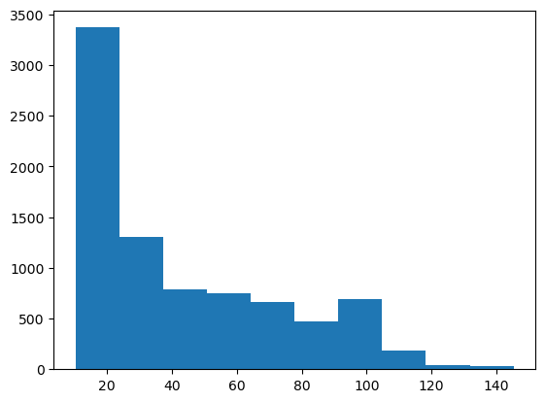
Outlier Detection
The histogram of the 'Price' column in the provided Oil Price dataset suggests that the distribution of oil prices exhibits some level of skewness or asymmetry.
1.Positive Skewness: If the right tail of the distribution is longer or fatter than the left tail, the distribution is positively skewed. The mean is typically greater than the median.
2. Negative Skewness: If the left tail of the distribution is longer or fatter than the right tail, the distribution is negatively skewed. The mean is usually less than the median.

Slide 10
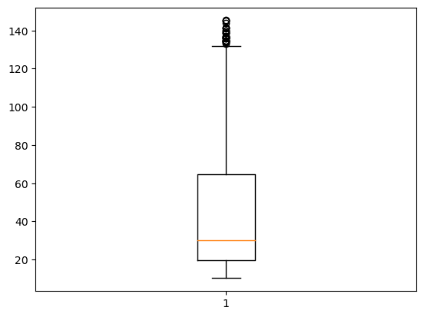
Box Plot
The boxplot of the 'Price' column in the dataset indicates the presence of potential outliers, with the majority of oil prices clustered within a relatively narrow range.
Outliers Detection: The boxplot reveals the presence of potential outliers in the 'Price' data, as indicated by points beyond the whiskers.
Central Tendency: The box represents the interquartile range (IQR), with the median line inside. It shows where the central tendency of the data lies.
Skewness and Spread: The asymmetry of the boxplot provides insights into the skewness of the distribution. A skewed distribution may have a longer whisker on one side.

Slide 11
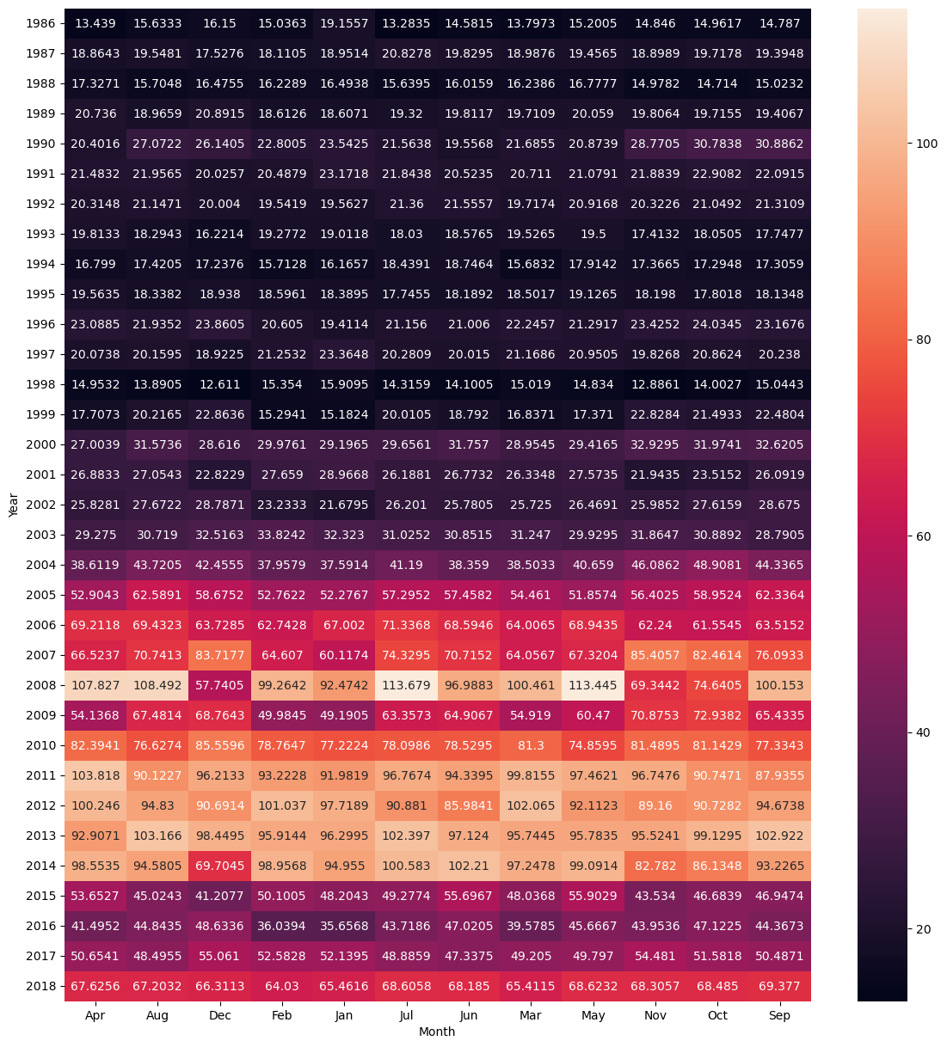
Heatmap
The heatmap visually represents the average 'Price' of a dataset (data4) across different 'Years' and 'Months', showcasing any discernible patterns or trends in a clear and structured manner.

Slide 12
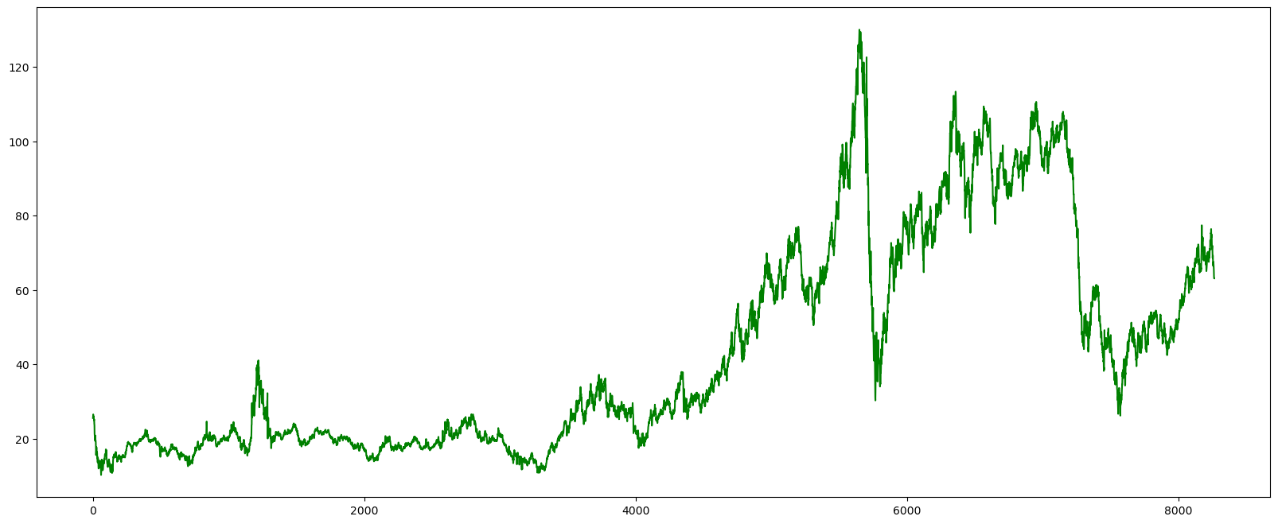
Line Plot
The line plot of 'Price' in the dataset (data4) reveals the overall trend, showing periods of both increase and decrease, with a notable spike in prices at certain points.

Slide 13
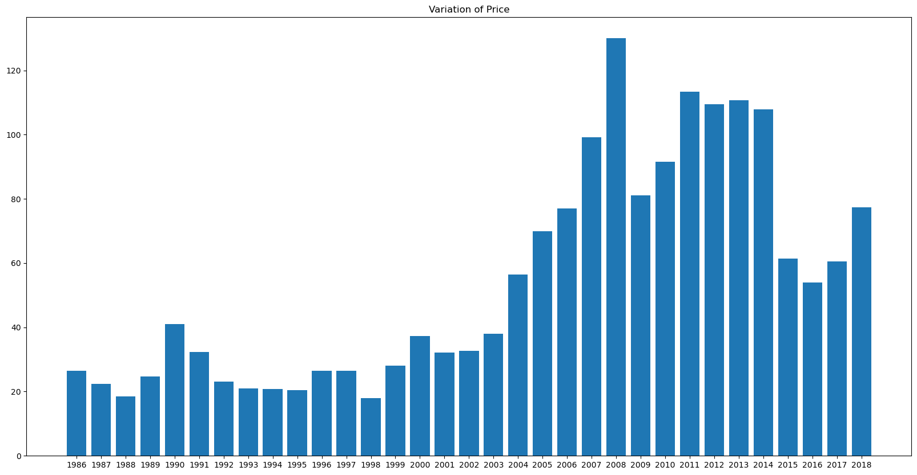
Bar Plot
The bar chart illustrates the year-wise variation of 'Price' in the dataset (data4), providing a clear visual representation of the fluctuations and identifying potential trends or anomalies.

Slide 14
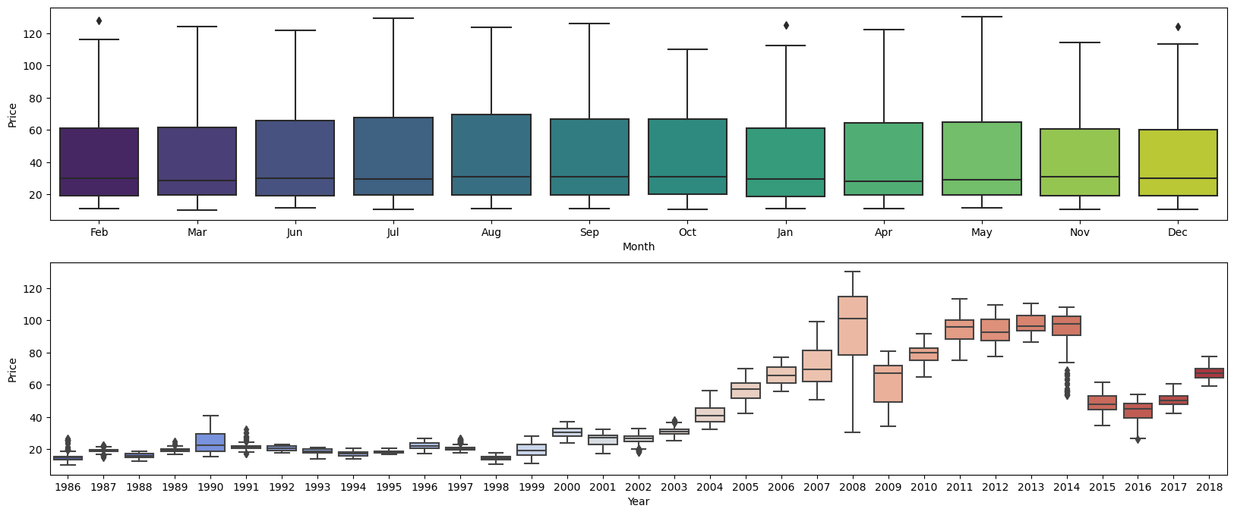
Sub Plot
The top subplot shows monthly variations in oil prices, highlighting potential differences in price distributions among months, while the bottom subplot displays yearly boxplots, offering insights into the distribution of prices across different years in the dataset.

Slide 15
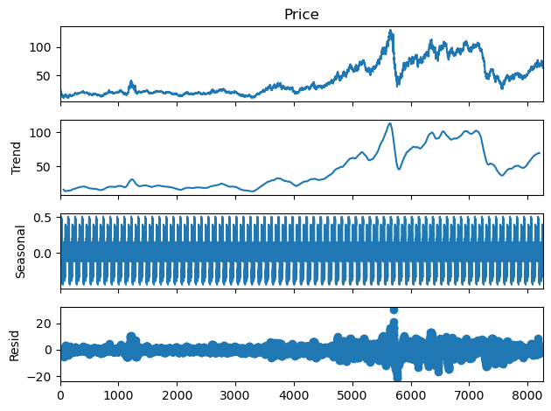
Time Series Decomposition
The additive seasonal decomposition plot of 'Price' in the dataset (data4) reveals underlying trends, seasonality, and residual patterns, providing a comprehensive view of the time series components.

Slide 16
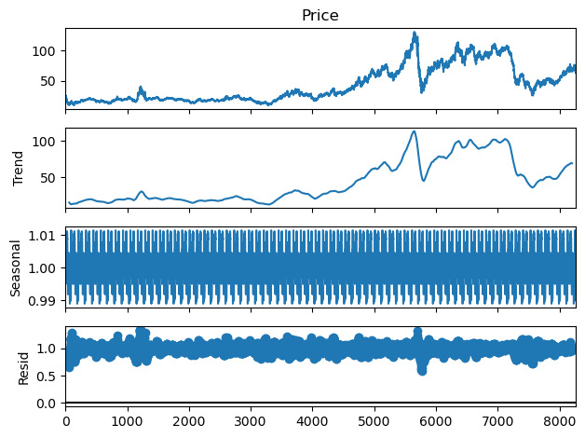
multiplicative seasonal decomposition plot
The multiplicative seasonal decomposition plot of 'Price' in the dataset (data4) exposes underlying trends, seasonality, and residual patterns, offering a comprehensive perspective on the various components of the time series.

Slide 17
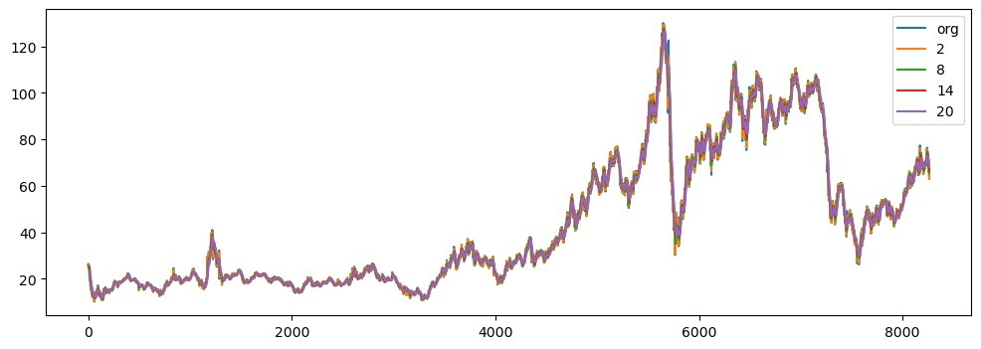
The plot compares the original 'Price' data with rolling mean trends calculated for different window sizes (2, 8, 14, 20), highlighting how these moving averages smooth out fluctuations and reveal potential patterns or trends over time.

Slide 18
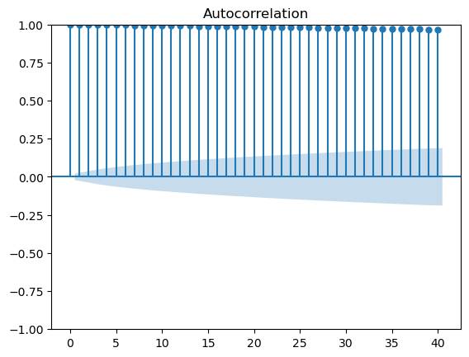
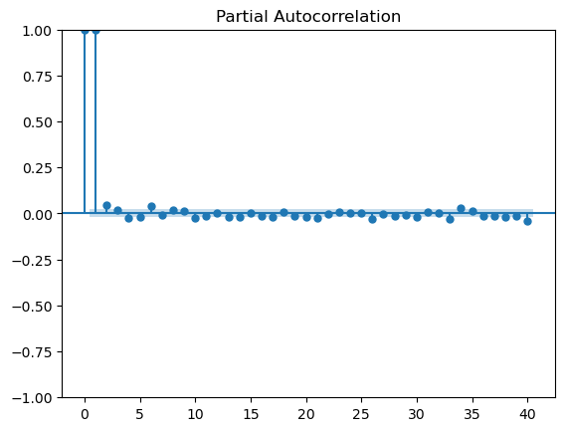
ACF and PACF Plots
ACF and PACF plots before applying transformations
The autocorrelation function (ACF) plot of 'Price' in the dataset (data3) illustrates the correlation of each data point with its lagged values, aiding in identifying potential patterns or seasonality in the time series data.
Definition: The ACF plot shows the correlation between a time series and its lagged values at different time lags.
Correlation Interpretation: Peaks in the ACF plot represent points where the time series has a high correlation with its past values.
Identification of Seasonality: Periodic spikes at specific lags may indicate seasonality, helping identify repeating patterns in the data.
Statistical Significance: Significant spikes outside confidence intervals suggest potential autocorrelation, guiding the selection of lag values in time series analysis.

Slide 19
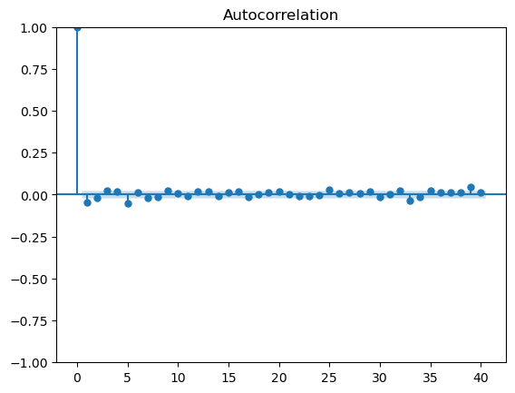
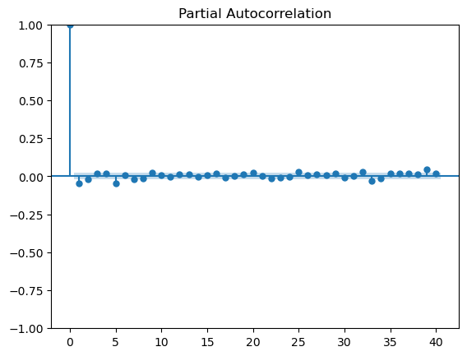
ACF and PACF plots after applying transformations
The autocorrelation function (ACF) plot of the first differences of 'Price' in the time series indicates a rapid decay in autocorrelation, suggesting that differencing has helped remove significant temporal patterns.
Differencing Purpose: The ACF plot of first differences is commonly used to transform a non-stationary time series into a stationary one.
Rapid Decay: The quick decline in autocorrelation values in the ACF plot indicates that differencing has effectively removed the temporal patterns or trends from the original time series.
Stationarity Achieved: Differencing aims to make the time series stationary, making it easier to model and analyze by stabilizing the mean and variance over time.
Identifying Model Orders: The ACF plot aids in identifying the order of differencing required and helps in determining the lag values for autoregressive (AR) components in time series models.

Slide 20
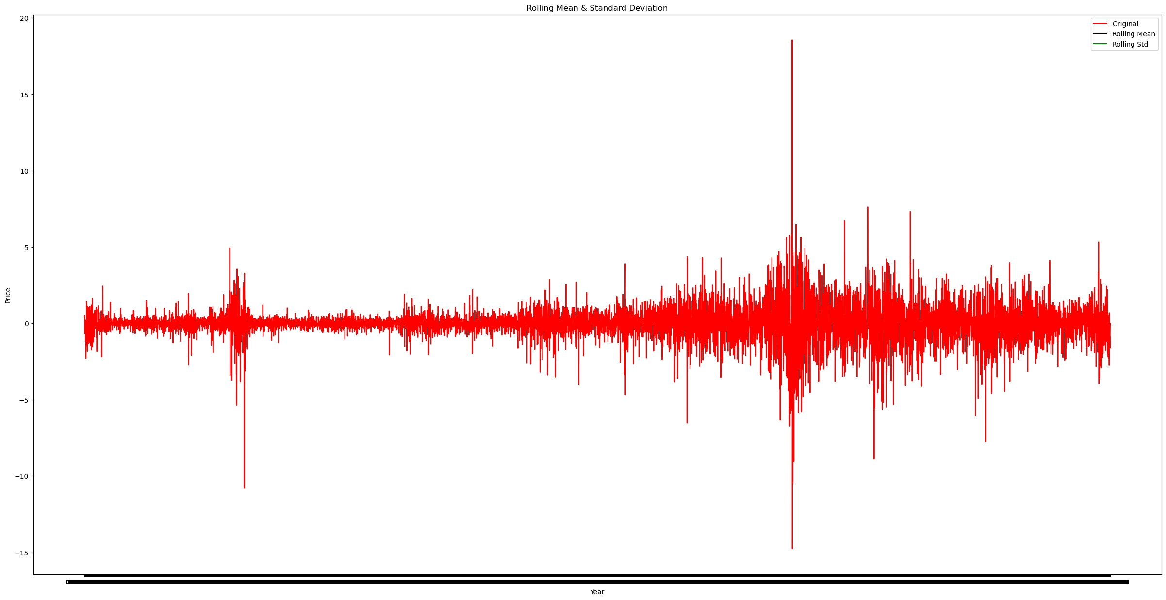
Time Series
The plot of the original time series alongside its rolling mean and standard deviation suggests that the data has been stabilized through differencing, and the Augmented Dickey-Fuller test confirms stationarity with a significant p-value.
Stationarity Check (ADF Test): The Augmented Dickey-Fuller (ADF) test is employed to assess the stationarity of the differenced time series. The test statistic and p-value are crucial outputs, with a low p-value indicating strong evidence against the null hypothesis of non-stationarity.
Rolling Mean and Standard Deviation: The rolling mean and standard deviation plots are effective tools for visualizing trends and variability in the time series data. The rolling mean provides insights into overall trends, while the rolling standard deviation indicates changes in variability over time.
Log Transformation: The natural logarithm transformation (np.log()) is applied to the differenced data before computing rolling mean and standard deviation. Log transformation is useful for stabilizing variance and revealing relative changes in the data.

Slide 21
Model Building :
Split the dataset into training and testing sets.
We will use the first 80% of the data for training and the remaining 20% for testing:
Mean Absolute Error (MAE):
● MAE measures the average absolute difference between predicted and actual values.
● Smaller MAE values indicate better performance.
Mean Squared Error (MSE):
● MSE measures the average squared difference between predicted and actual values.
● Smaller MSE values indicate better performance.
Root Mean Squared Error (RMSE):
● RMSE is the square root of the MSE, providing a measure of the average magnitude of the errors.
● Smaller RMSE values indicate better performance.

Slide 22
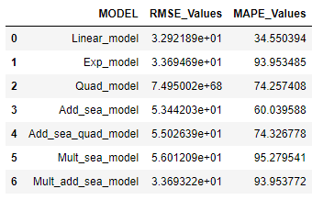
Time Series Modelling
Model Based Method
First we tried Simplest forcasting models like Linear Model,
Exponential Model, Quadratic Model, Additive Seasonality Model, Additive Seasonality Quadratic Model, Multiplicative Seasonality Model, Multiplicative Additive Seasonality Model.
We used Ordinary Least Squares model from stats models.

Slide 23
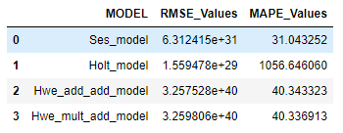
Data Driven Models
We have tried Simple Exponential Smoothing,
Holts method, Holts Winter with Additive Seasonality &
Additive Trend, Holts Winter with Multiplicative Seasonality
And Additive Trend.
Here We got Simple Exponential Model with Least Errors.
And less than Model Based Methods.

Slide 24
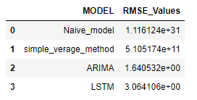
Other Forecasting Models
We Have also used Models like Naive's Model, Simple Average Method, Auto Regressive Integrated Moving Average (ARIMA), Long Short Term Memory (LSTM) model.
With ARIMA having lowest RSME value among all the models used till now.
We Are finalizing LSTM as our Model for Deployment.

Slide 25
Model Deployment
We used LSTM Model for deployment.

Slide 26
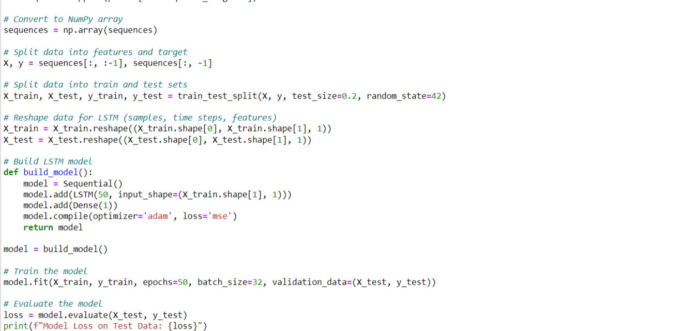
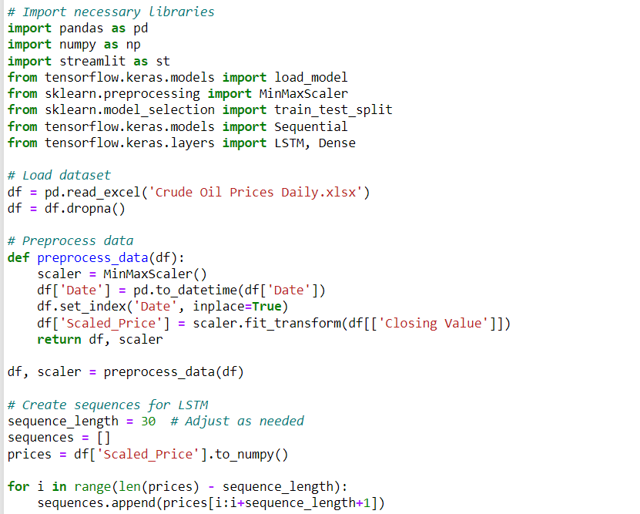
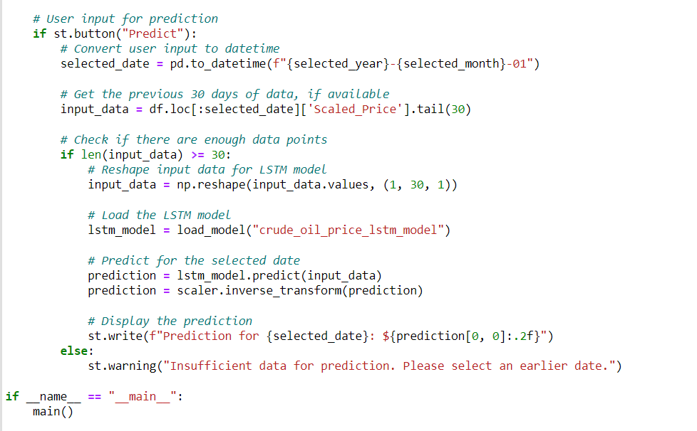
Codes For Deployment

Slide 27
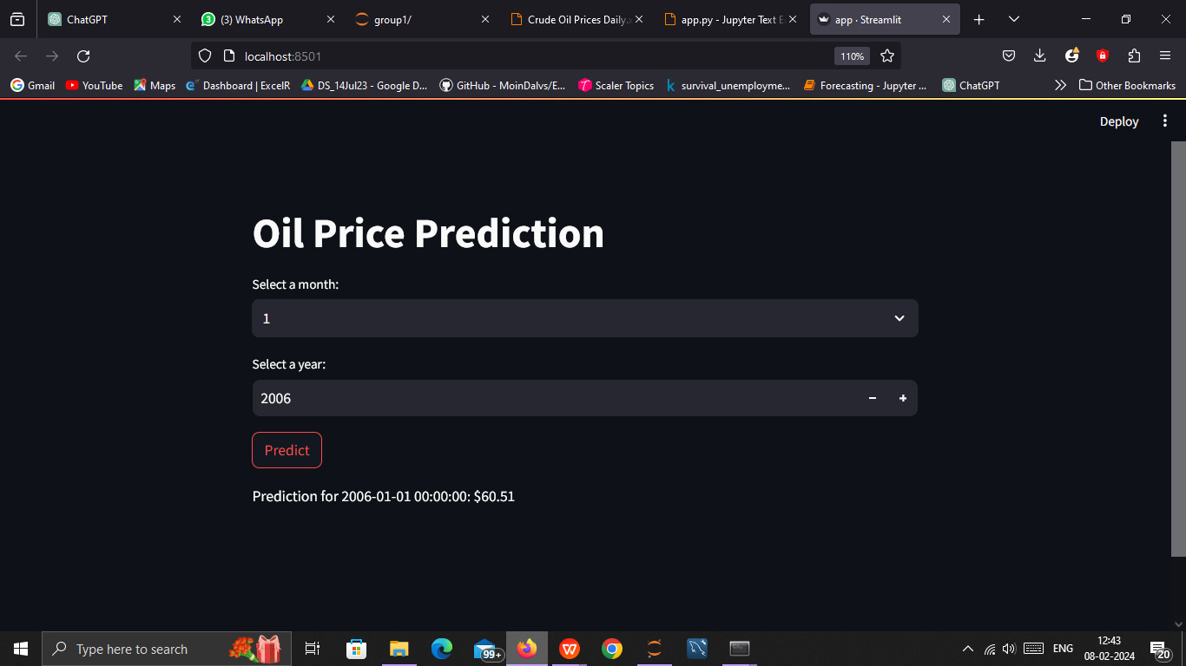
Predict the Model
We used LSTM Model for deployment.

Slide 28
Challenges
● Installation of Libraries (Different IDEs behaved differently)
● Ensuring quality and reliability of data
● Handling missing data & Outliers
● Looking for data visualizations and normalising it
● While building model, faced an issue with accurac

Slide 29
How Team overcame Challenges
● Preformed EDA and feature engineering to make data reliable
● Tried multiplied IDEs and settled with one
● For errors, read various articles through google search
● Tried multiple models and compared the same

Slide 30
“Thank you for your attention.”
“I hope you found this presentation informative.”

